Slide 1
P3: Skin Graft Application
[Report Slides]

Slide 2

Team Members & Collaboration
Blessy Kuriakose (blessykuriakose@my.unt.edu)
Nick Torres (nicholastorres@my.unt.edu)
Asherpranay Palle (asherpranaypalle@my.unt.edu)
Sruthi Bharath Kumar (sruthibharathkumar@my.unt.edu)
Mica Haney (micahaney@my.unt.edu)
With assistance from Gagan Sai Ram Anvesh Achanta and Abhijit Talluri for project continuation.
Weekly meetings are scheduled for Mondays at 4pm in the classroom. Members who cannot be physically present can arrange to attend via Zoom.

Slide 3
Abstract
“Burn Injuries are one of the most common and devastating afflictions on the human body. Currently, treatments for burns can be effective but rely on estimations of burn area that take time and can be error prone. By improving this process doctors can give better care to patients. In collaboration with the Department Of Surgery at Loyola University Chicago, we have created an application that tackles these issues. With our application, pictures of burn patients will be taken, one from the front and one from the back, skin and burn segmentation will be performed, and then an accurate percentage of the burn area will be calculated. This application would make burn area estimation, skin graft planning, and burn treatment process more precise and efficient for doctors.”
(From P2’s presentation slides)

Slide 4
Overview
In previous works on this project, a cross-platform app was created using Kivy to take an image of the area of interest on which the implemented codes can run. Code has currently been developed to segment out the areas of skin in the image. (This annotation is viewable via the LabelBox platform.)
The dataset used for previous iteration tasks contain web-scraped images of different burn degrees (1, 2, and 3) all annotated using ‘coco format’ to show bounding boxes of the burned area as well as the class/category of the burn degree. (Labels converted from the original yolo format in previous iterations.) [LINK]
For this iteration we will be attempting to segment the skin lesion areas of a stand-in dataset by training on a U-Net model.

Slide 5
Previous Iteration

Slide 6
Project Design & Milestones
1st Iteration
In the event of a fire, a burn will appear on the victim's skin. We want to automatically identify the burn area from a given photograph or picture and indicate the percentage area of burn as well as the degree of burn but in the previous data the degree of burn isn't considered so here we use a new data set in combination with the old dataset and include degree of burn from the dataset mentioned above. We'll work on converting the data from YOLO Bounding box format to object detection segmentation format in this iteration. Here in this iteration we have received dataset in coco format but yet segmentation is to be done and issues with app are yet to be resolved

Slide 7
Project Design & Milestones
2nd Iteration
The main idea in this iteration is to identify a Machine Learning Model that is best suited for edge devices processing data locally, reducing reliance on cloud networks for segmenting the skin as well as burnt areas, which will be trained on the burned dataset to identify the burn area, classify the burnt area based on the degree of burnt area, and then calculate the percentage of burn (Percentage of Burn: the area of skin burn/ Total area of Skin) by degree. But due of lack of time and issues with annotation tools we could only get skin part segmented while rest are yet to be done for which I will provide with a coco dataset visualization tool and the app work is also due

Slide 8
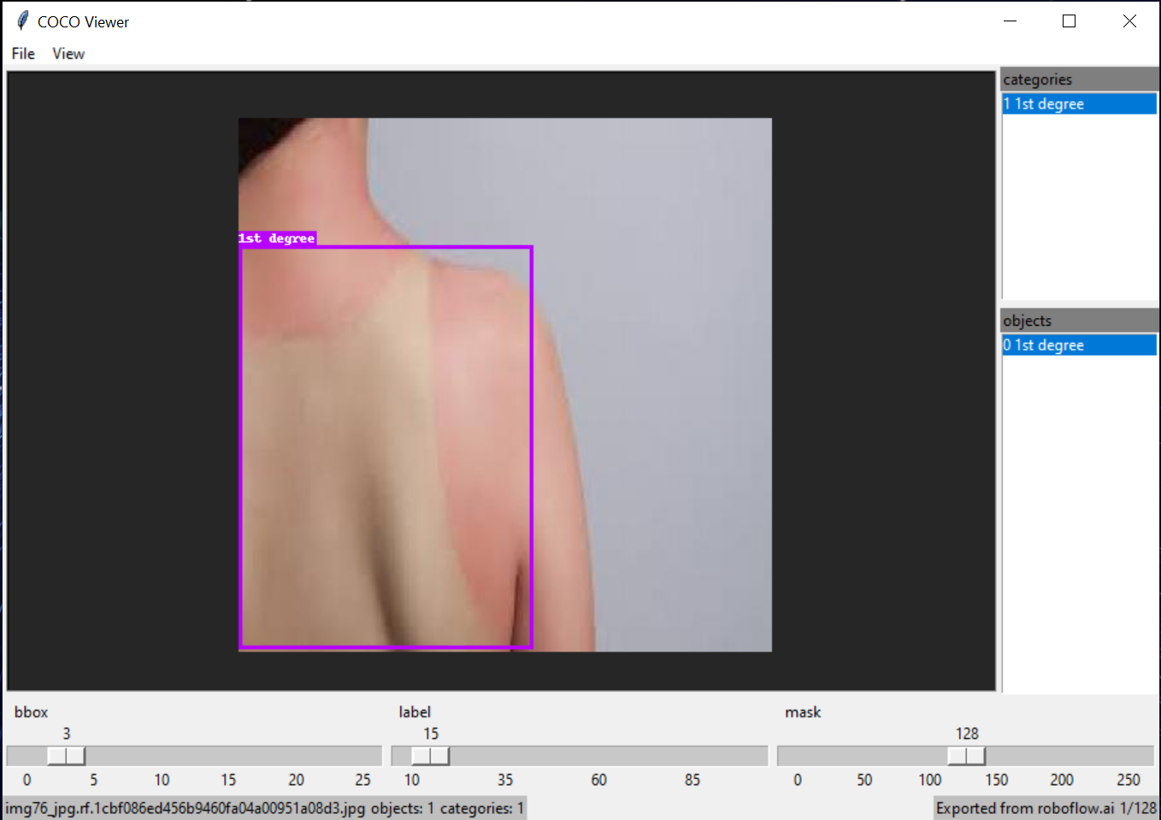
Dataset sample (after coco annotations)

Slide 9
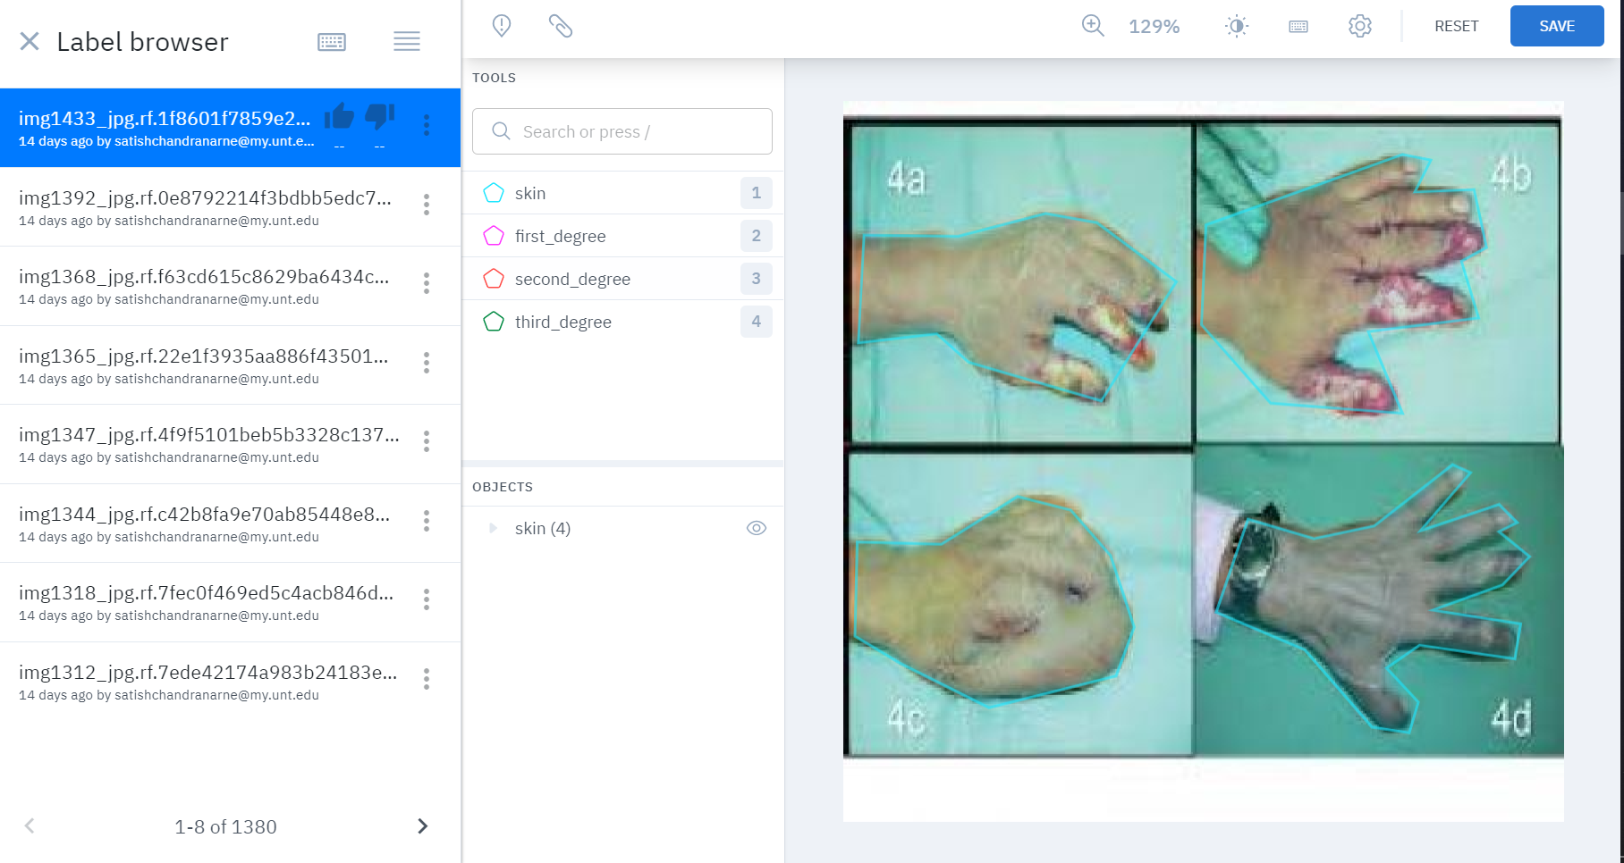
LabelBox skin segmentation annotations.

Slide 10
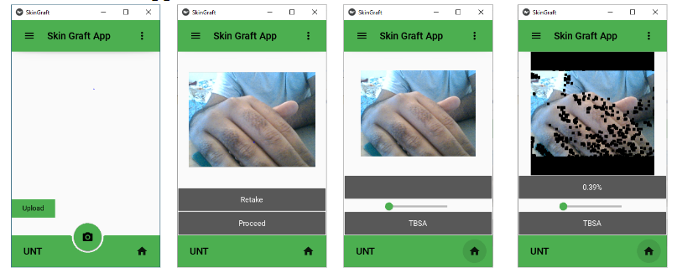
Kivy app implementation. (Copied from P2 presentation slides.)

Slide 11
This Iteration

Slide 12
Project Design & Milestones
3rd Iteration
For this iteration we initially planned to trained a new model to segment images based on where in the image a burn appears, however due to difficulties in creating burn annotations for segmentation, we have started building a model on a different dataset. Future work can follow up on this model architecture when building the segmentation model for the burn images. We have worked on a few annotations of the burn images on labelbox, but nowhere near enough to train a model.

Slide 13
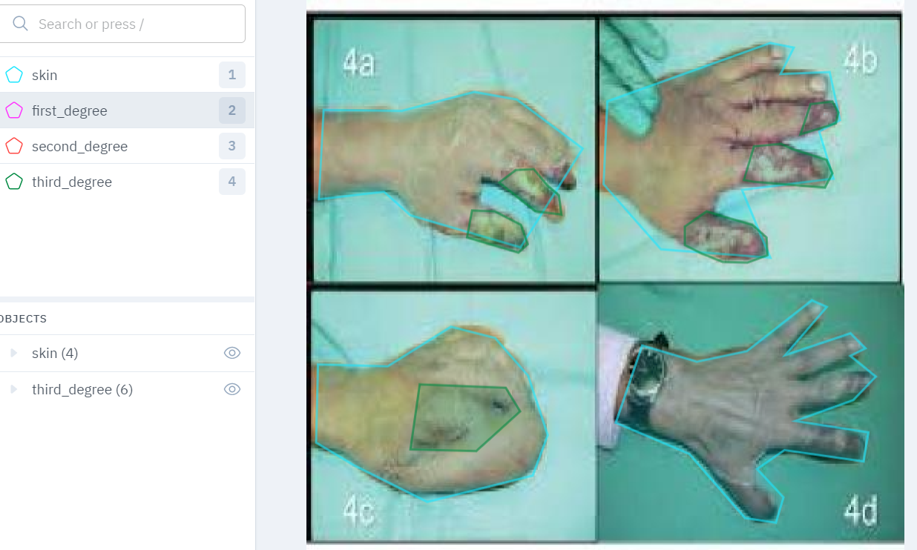
Annotations on Burn images
Burn annotations were started using LabelBox, however due to the difficult and time-consuming nature annotating the data were discarded as a task.
Coco (boundary-box) annotations have to be viewed in a specific viewer through which you need to click through individual images.
These images have a different order in LabelBox --the tool used to do manual segmentations for the burns-- so tracking between the images to annotate and the the known boundary boxes of burns within that image became a time consuming task.

Slide 14
Works/ Milestones
Milestones:
Find a new dataset (skin lesion dataset).
Start annotation of original dataset (skin burn dataset)
Get dataset loaded into Google drive.
Run model without errors.
Run hyperparameter tuning experiments.
Run final experiment(s).

Slide 15
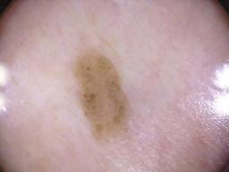
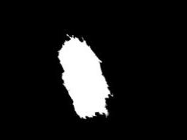
Data
Skin Burnt Dataset: Due to difficulties creating segmentation annotations for this dataset, which we will discuss later, we have decided to build/train a model around another dataset, the Skin Lesion Dataset, which comes with segmentation annotations. This can model format can later be used for the Burn Dataset after annotations are complete.
Skin Lesion Dataset: This dataset comes with several images of skin lesions, pre-split into train, test, and validation sets, and with masks readily available. Details are given below.
Number of images by subset
Train | 2000
Validation | 150
Test | 600

Slide 16
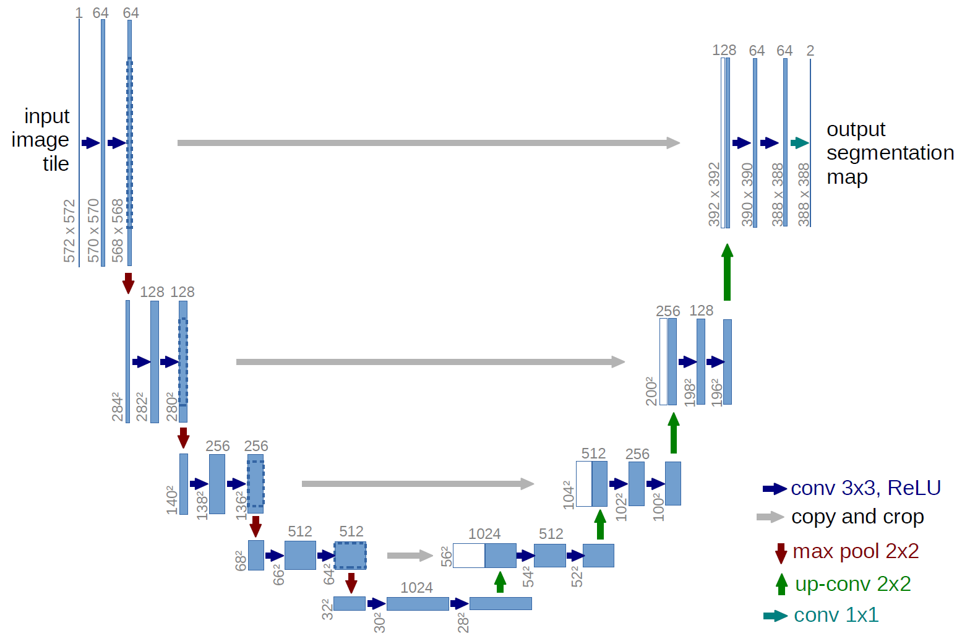
Model
The model is the pre-defined architecture of UNET, from (Ronneberger et el., 2015)

Slide 17
Hyperparameters
Most of the original hyperparameters were not changed.
Learning Rate: 1e-4
Batch Size: 16
Num. Workers: 2
Pin Memory: True
Load Model: False
However, we did have to change the input shape, and a short hyperparameter tuning experiment had us change the number of epochs to avoid overfitting.
Input Shape: (192, 256, 3)
Num. Epochs: 10, 1

Slide 18
Experiments
Four experiments were run in total. The first three with epochs=10 to find the ideal number of training epochs. The last was run with 1 for our final result.

Slide 19
Results
The task is to, for each pixel in an image, predict if that pixel is a part of the burn. The resulting predictions are used to create an image mask.
Results are measured in accuracy - the total correctly labeled pixels - and with a dice score, which is a modified precision score.
dice_score = (2 * (preds * y).sum()) / ((preds + y).sum() + 1e-8
Experiment | Epochs | Loss (Final) | Accuracy (Final) | Dice Score (Final)
1 | 10 | -151 | 46.01 | 1.779
2 | 10 | -167 | 53.34 | 1.805
3 | 10 | -147 | 51.36 | 1.792
4 | 1 | -44.7 | 76.38 | 1.644

Slide 20
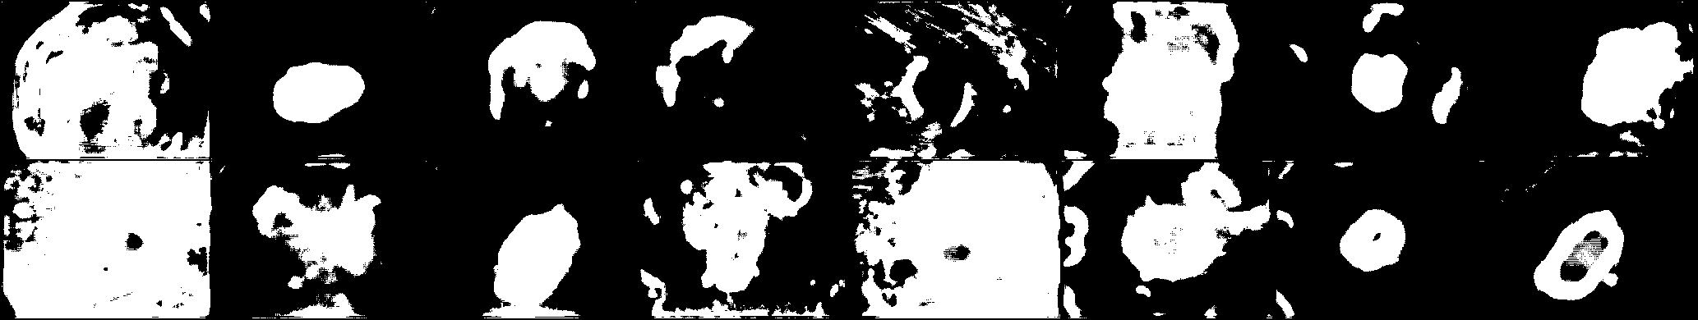
Discussion
The final model has an okay score, but not a great one. Looking at some of the prediction images, the edges of a lesion are often difficult for the model to pick up. Overall this model needs more work to be viable.

Slide 21
General Summary / Future Works
Completed
Burn dataset has been changed to coco-annotations. (Bounding box annotations.)
Skin segmentation annotations via LabelBox.
Skin segmentation model.
Kivy app deployment for skin segmentation on desktop.
New model created for segmentation on alternate dataset.
To be completed/solved
Burn segmentation annotations on the new dataset. (Started.)
Tailoring segmentation model for burn images and furthering it for classification of burns.
Combining the burn segmentation and classification features to the existing app and having it in working order on multiple platforms. (Might need to utilize a backend to avoid crashing.)
***Dataset by default refers to the original skin burn dataset, unless otherwise specified as “alternate” or “new.”

Slide 22
Archive
All code and data is contained in a Google drive.
https://drive.google.com/drive/folders/1O-Yu1XJynZOES_xhKSiCCcFlnnFLKSqO?usp=sharing

Slide 23
Resources
Prashant Brahmbhatt. (2019, December). Skin_Lesion_Segmentation, Version 1. Retrieved November 30 from https://www.kaggle.com/datasets/hashbanger/skin-lesion-segmentation.
Ronneberger, O., Fischer, P., & Brox, T. (2015, October). U-net: Convolutional networks for biomedical image segmentation. In International Conference on Medical image computing and computer-assisted intervention (pp. 234-241). Springer, Cham.
Semantic_segmentation_unet [Computer software]. (2021) Retrieved from https://github.com/aladdinpersson/Machine-Learning-Collection/tree/master/ML/Pytorch/image_segmentation/semantic_segmentation_unet

